Slide 1

Intro to K8s ecosystem 101
CNCF Student User Group Launch - May 2021
Divya Mohan

Slide 2
My Experience

Slide 3
Community
Notes:
Owner: Divya
Timebox: 5mins

Slide 4
What you should know
The K8s community is organized into subgroups as below:
Special Interest Groups, SIGs
Subprojects
Working Groups, WGs
Committees
User Groups

Slide 5
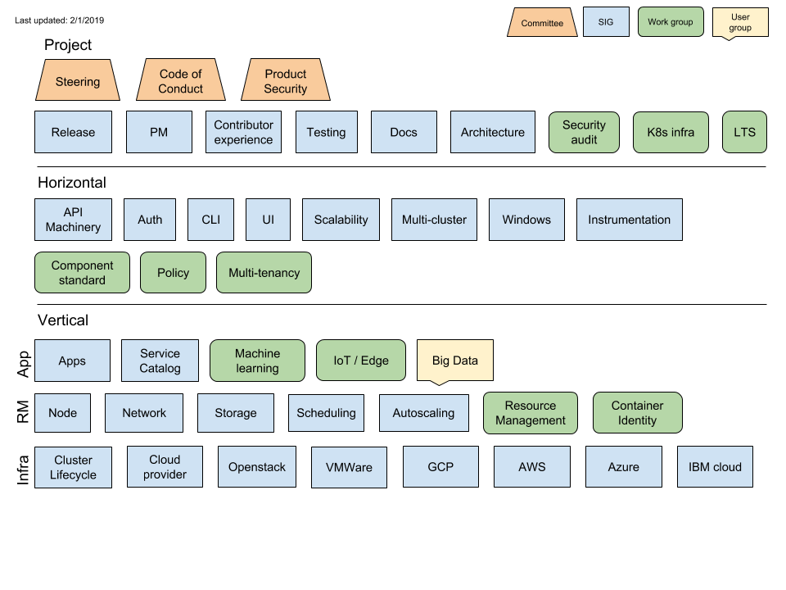
What you should know

Slide 6
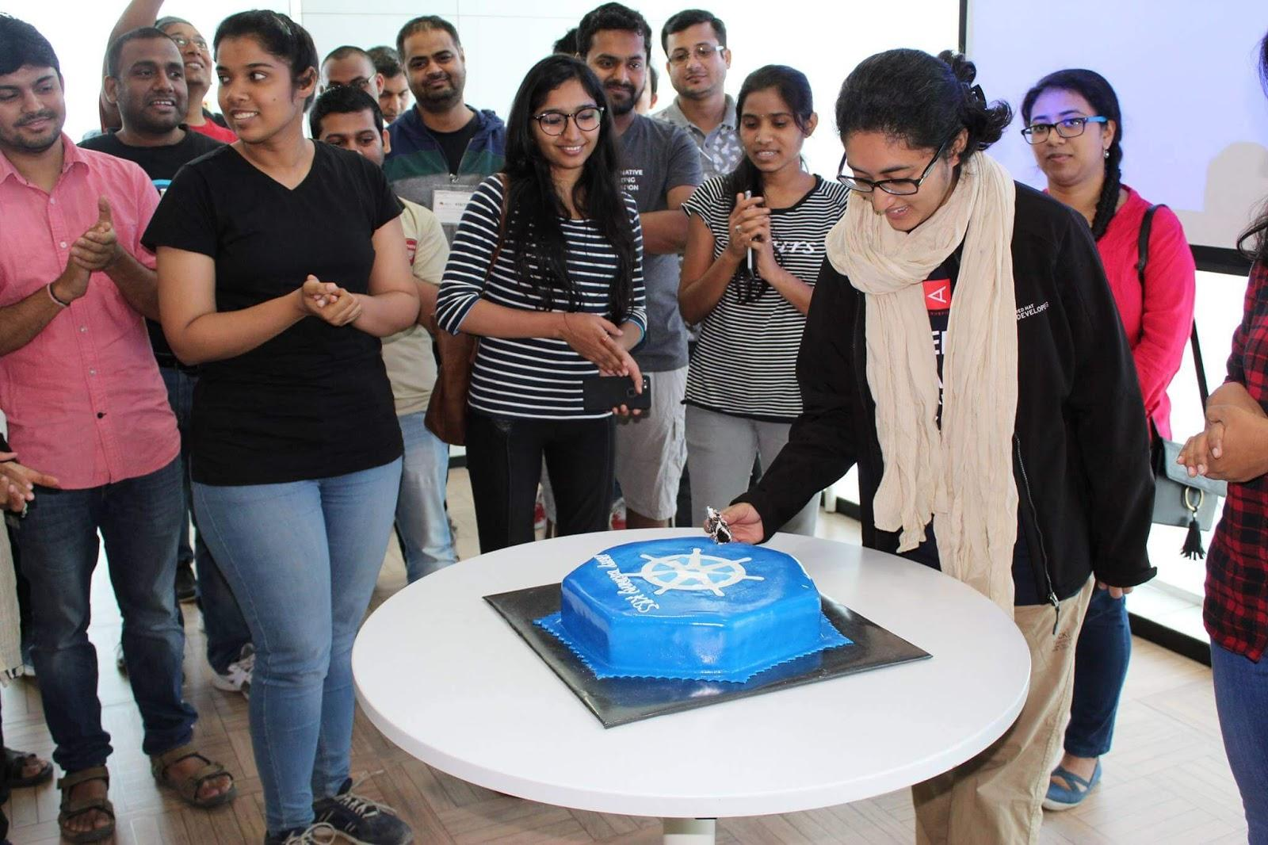
Special Interest Group
SIG sounds like of like a meetup group, and it both isn't and also is.
Each SIG is its own sub-community in Kubernetes, because it's a huge project and we can't all be in one giant pool of 2000 contributors.

Slide 7
Types of SIGs
Feature Areas
Plumbing
Meta
Docs
Cloud Provider

Slide 8
Feature Area SIGs
sig-auth
sig-apps
sig-autoscaling
sig-cli
sig-multicluster
sig-network
sig-node
sig-scalability
sig-scheduling
sig-service-catalog
sig-storage
sig-ui

Slide 9
“Plumbing” SIGs
sig-api-machinery
sig-cluster-lifecycle
sig-instrumentation

Slide 10
Meta
sig-architecture
sig-contributor-experience
sig-pm
sig-release
sig-testing

Slide 11
Documentation & Website
sig-docs
sig-docs-blog
sig-security-docs

Slide 12
Cloud Provider
Individual cloud providers are Subprojects of this SIG.
List of Cloudprovider Subprojects

Slide 13
Working Groups and Subprojects
Working Groups: inter-SIG efforts
Subprojects: focus areas for SIGs
For specific:
Tools (ex. Kubectl)
Goals (ex. Code Cleanup, Contributor Site)
Areas (ex. Machine Learning)

Slide 14
Working Groups
wg-apply
wg-component-standard
wg-iot-edge
wg-k8s-infra
wg-lts
wg-machine-learning
wg-multitenancy
wg-policy
wg-resource-management
wg-security-audit

Slide 15
Subprojects
cloud tools
kustomize
kind
kubebuilder
federation-v2
contributor-site
Usually found in kubernetes-sigs/ namespace
Examples include...

Slide 16
User Groups
No codebase ownership
Topics of interest shared across large groups of users
Big Data

Slide 17
Committees
project governance oriented
join by invite or election only there are currently three committees:
Steering Product Security Code of Conduct
https://github.com/kubernetes/community/blob/master/README.md#governance

Slide 18
Picking the right SIG
Figure out what specific projects/areas you want to work on.
Find out which SIG/WG/subproject covers that
Ask on #sig-contribex
Go to the SIG intros at this conference
Join that SIG/subproject
If joining a WG/subproject, also join a SIG

Slide 19
How Do I Join A SIG?
Join the sig-specific mailing list. This is open to anyone.
That’s it. You’ve joined a SIG.
Notes:
Go to k/community
Navigate to sig-architecture
Scroll down to the README mailing list section
Click on the link
And then Click on Join

Slide 20
Quick reference
Governance reference
Project Group List sigs.yaml configuration file

Slide 21
Communication

Slide 22
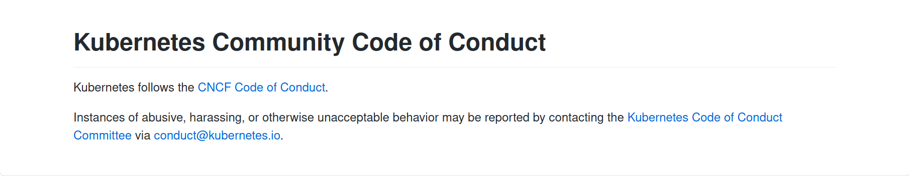
Before we get started

Slide 23
Keeping in touch
How do we do it?
Mailing List
Slack
Zoom meetings
Some async initiatives:
Alternating between Slack threads & Zoom meetings in #sig-contribex
APAC friendly timings introduced for Release team meetings
More talk on Slack and Mailing Lists, less reliance on Meetings

Slide 24
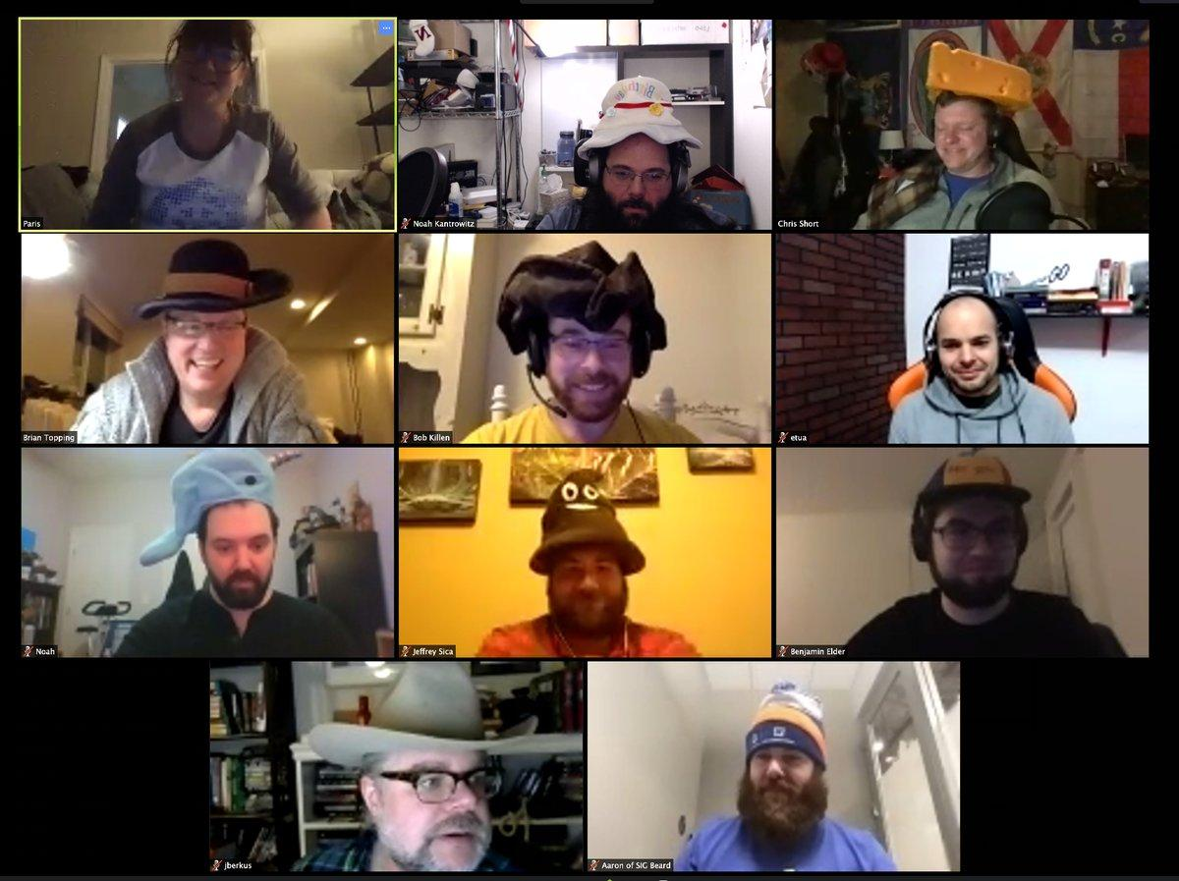
Meetings

Slide 25
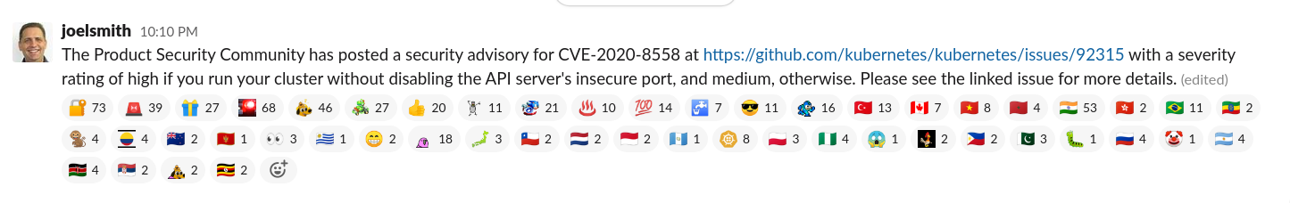
Slack - emojis!

Slide 26

India specific Slack channels
Step 1
Join the Slack -> slack.k8s.io
Step 2
Find #in-dev, #in-users, #in-events
Step 3
Say Hi! 👋, introduce yourself and send emojis!!!

Slide 27
Release Shadow program

Slide 28
What is the Release Shadow program?
Follows the apprenticeship model
Similar to trainee positions on other teams
Helps contributors broaden their area of knowledge + increase participation in the project
More information: https://github.com/kubernetes/sig-release/blob/master/release-team/shadows.md

Slide 29
How to find your first issue?
Notes:
Owner: Divya Timebox: 15mins
Ref: https://github.com/kubernetes/community/blob/master/community-membership.md

Slide 30
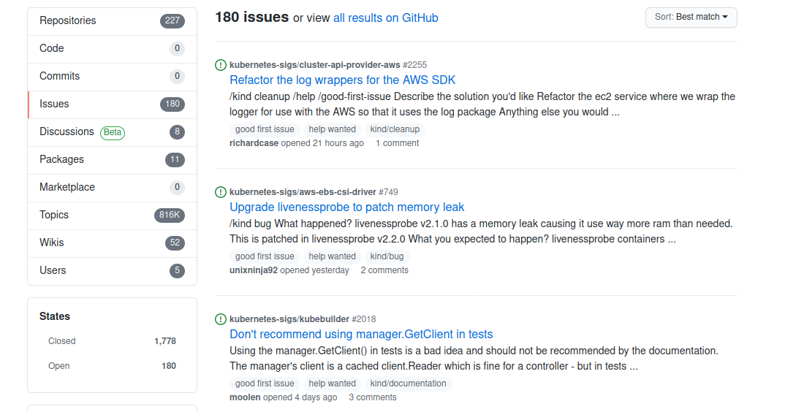
Good first issues
https://go.k8s.io/good-first-issue
Source: Bob Killen/Sahdev Zala on #sig-contribex
Notes:
https://go.k8s.io/good-first-issue

Slide 31
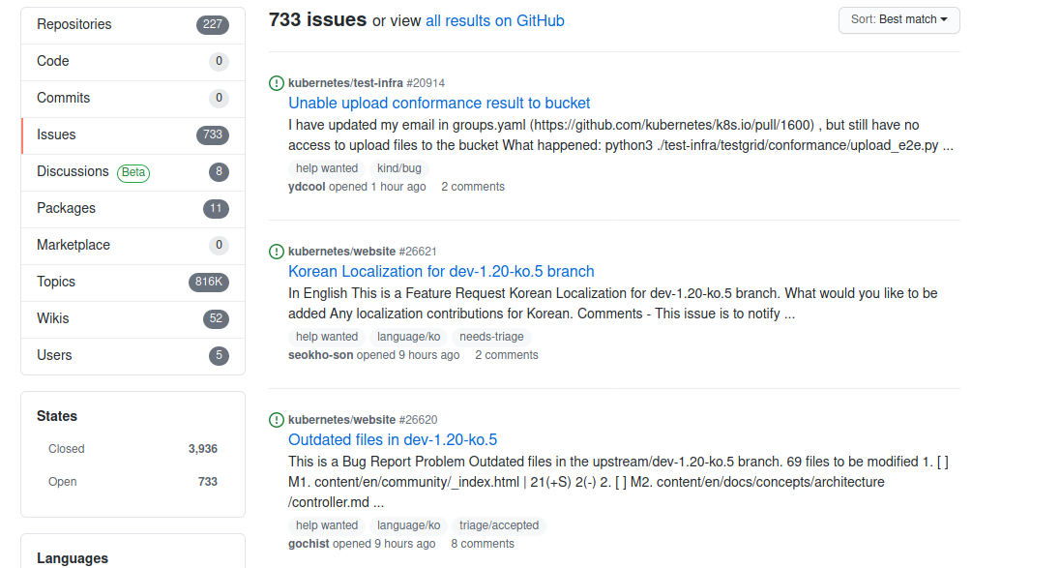
For the initiated
https://go.k8s.io/help-wanted
Source: Bob Killen/Sahdev Zala on #sig-contribex
Notes:
https://go.k8s.io/help-wanted

Slide 32
Getting involved
Different roles in the contributor ladder:
Member
Reviewer
Approver
Subproject owner

Slide 33
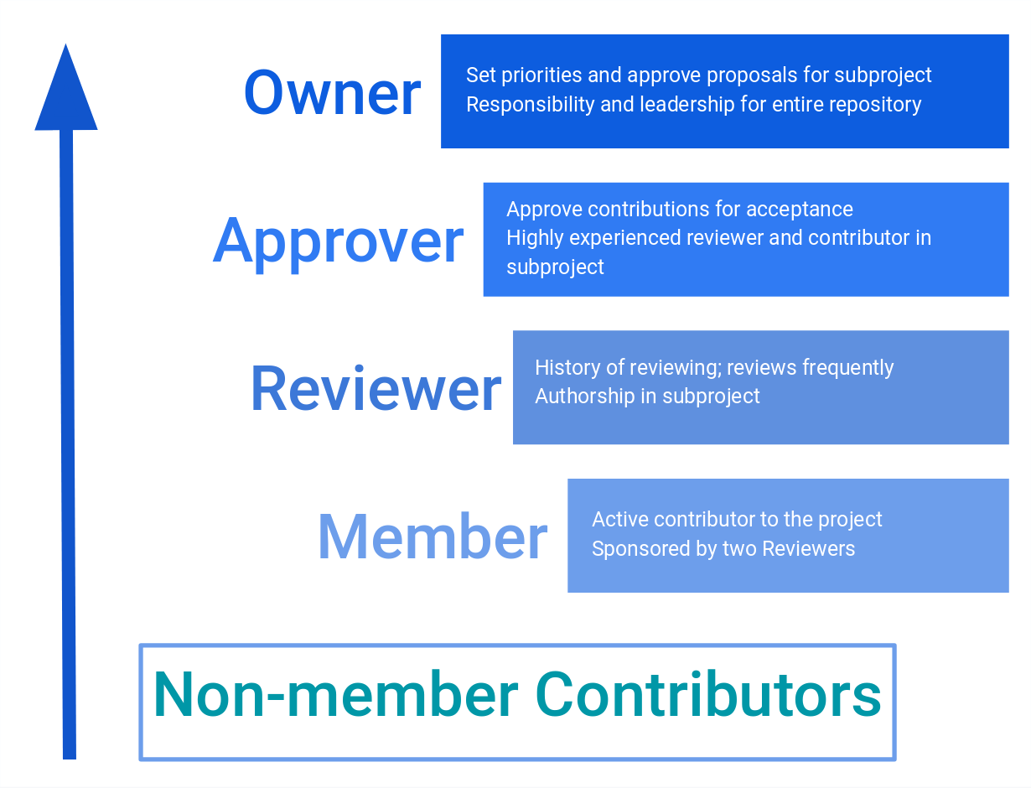
Getting involved

Slide 34


